Slide 2
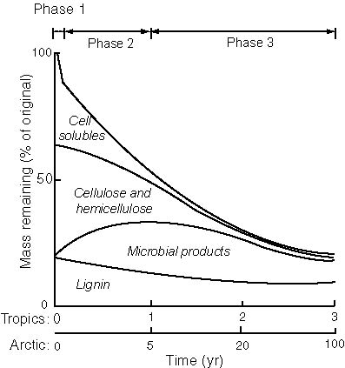
Phases of decomposition

Slide 3
Climate
(environmental conditions)
Plant litter quality
Decomposers
(chemical composition)
(nature and abundance)

