Slide 1



Engaging students in the practice of science through an international, long-term decomposition study
October 17, 2016
Kari O’Connell (Oregon Natural Resources Education Program)
Rima Givot (Sisters High School)
Jeremy Magee (Sandy High School)
Notes:
Welcome!!!
Introduce my co-presenters ☺
We are going to tell you about a student long-term decomposition study that is based upon current research on carbon cycling and a partnership with a colleague in Israel.

Slide 2
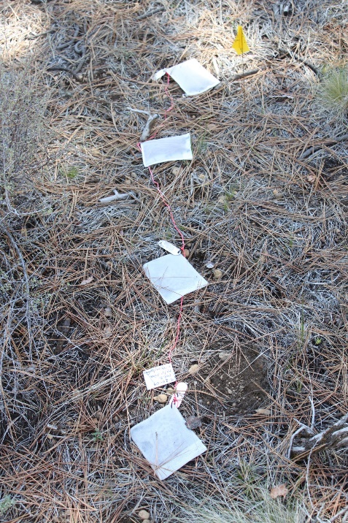
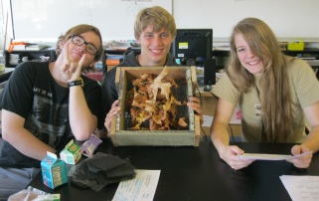
Goal
Students act as scientists by contributing data to an Oregon-wide leaf litter-bag decomposition study that is part of an international long-term ecological research effort.

Slide 3
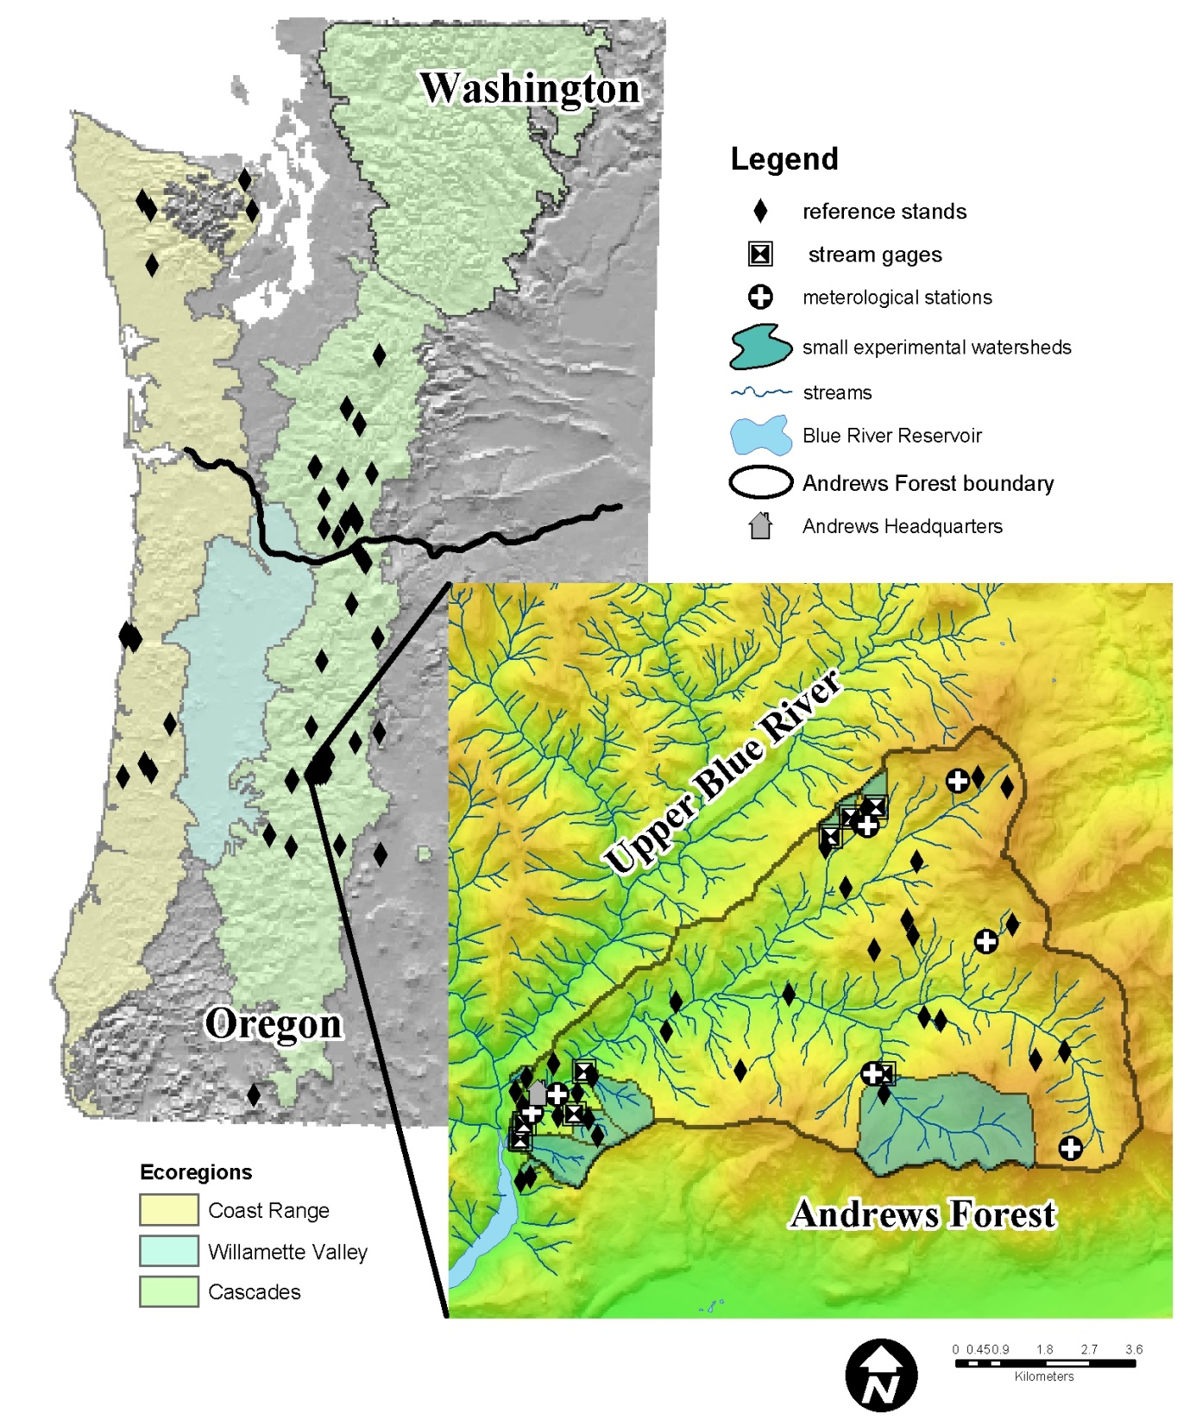
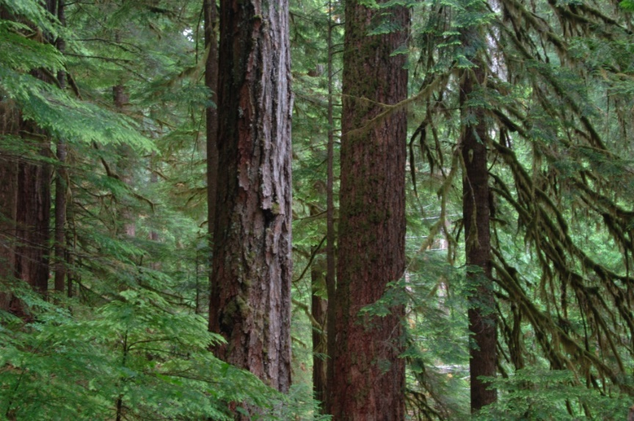
H.J. Andrews
Experimental
Forest
Notes:
I work with ONREP at OSU – we are the K-12 education partner for the HJA, located near McKenzie Bridge, between Sisters and Eugene.

Slide 4
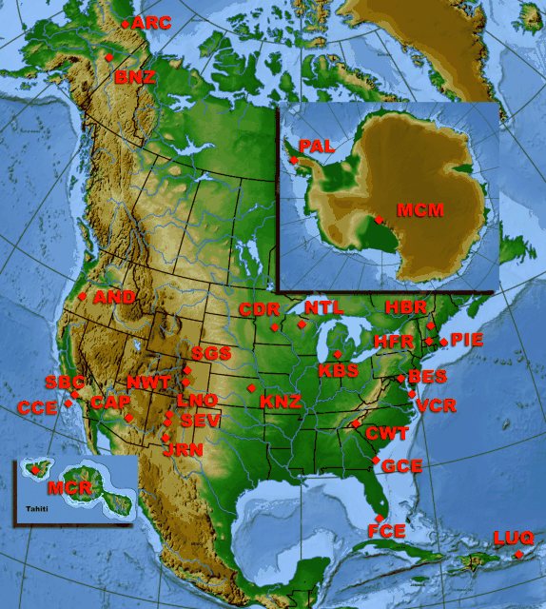
Long-Term Ecological Research Program
Long-Term Ecological Research Program
The Long Term Ecological Research (LTER) Network was created by the National Science Foundation (NSF) in 1980 to conduct research on ecological issues that can last decades and span huge geographical areas.
Notes:
We are one of 26 sites in the LTER network.

Slide 5
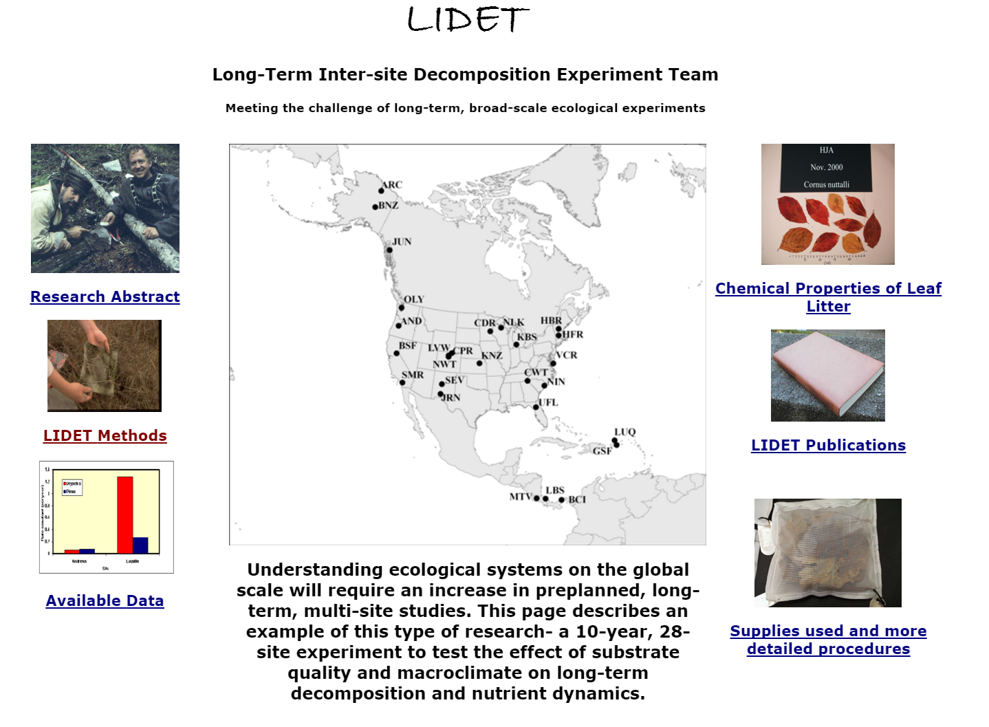
Notes:
One of these such studies – as a process that is very important to the carbon and nitrogen cycle, scientists are interested in understanding the controls of decomposition on a broad-scale, long-term ------LIDET – U.S.-wide study investigating the effect of substrate quality (material) and climate on decomposition.

Slide 6
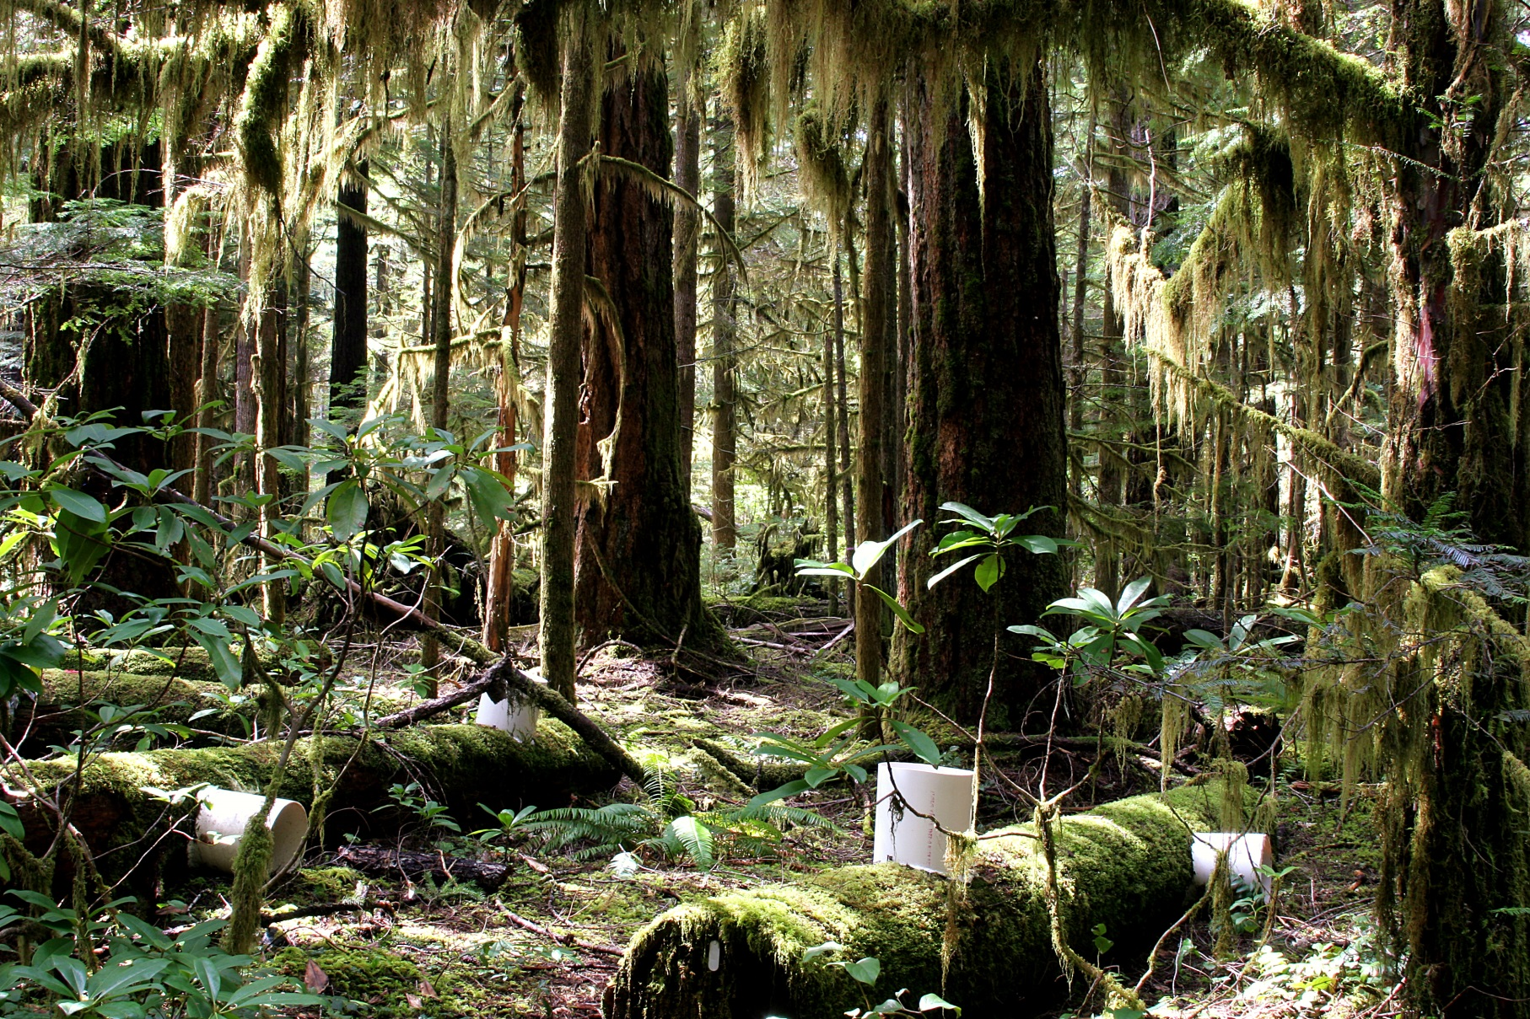
200-year Log Decomposition Experiment
Examines the effect of substrate quality and colonization patterns on log decomposition.
Six field locations at the Andrews Forest.
Twenty logs from each of four tree species.
Notes:
One of major areas of study that we’ll get to hear more about is decomposition and all that goes with that – both large and small-scale, long- and short-term.

Slide 7

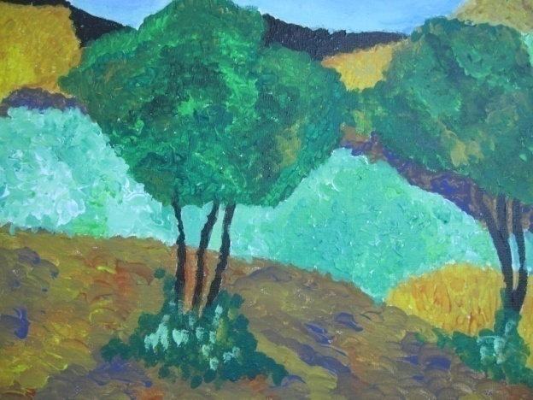
The concept: students monitor their environment- LTER-EDU at Ramat Hanadiv
LTER-EDU
LTER-
Long Term Ecological Research
Environment –ecological changes over time and space
Notes:
7
Our idea is that students can be involved in these kinds of studies as well – broad-scale, long-term. LTEr program has an international component as well-
Israel

Slide 8
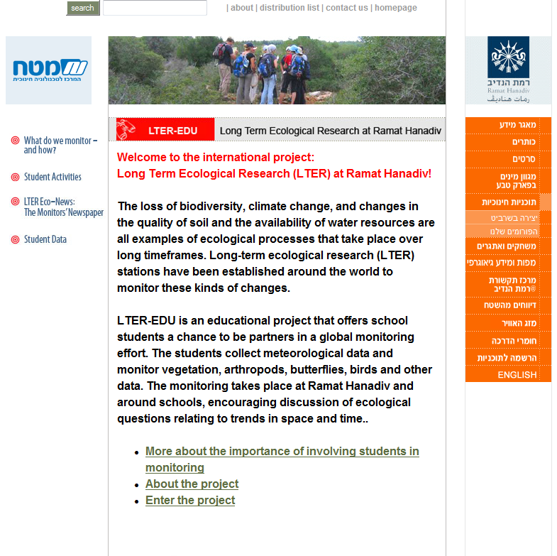
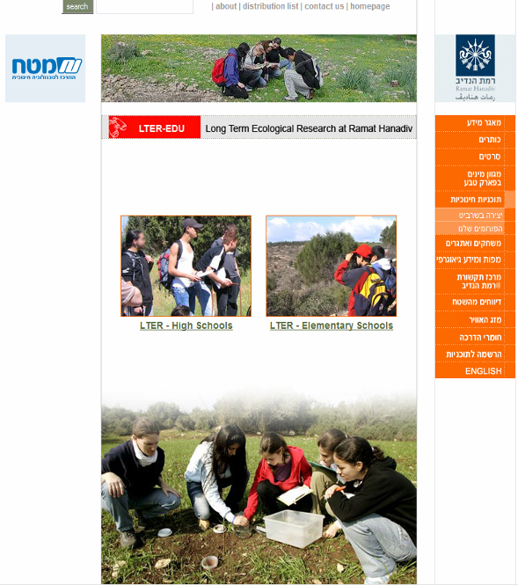
Notes:
8
This project is in collaboration with the Israeli LTER site – they have a whole program where students monitor climate, biodiversity, etc. at their site – they added decomposition to this after learning about our Andrews LTER research.

Slide 9
Long-term decomposition study -
Authentic, hands-on science
Connecting to other classrooms doing the same
Environmental literacy
Data literacy
Support NGSS and important
science concepts
Notes:
We invited you here today with these outcomes in mind – for you and your students -

Slide 10
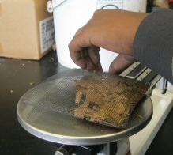
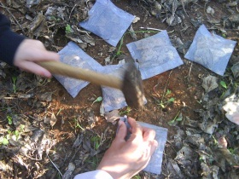
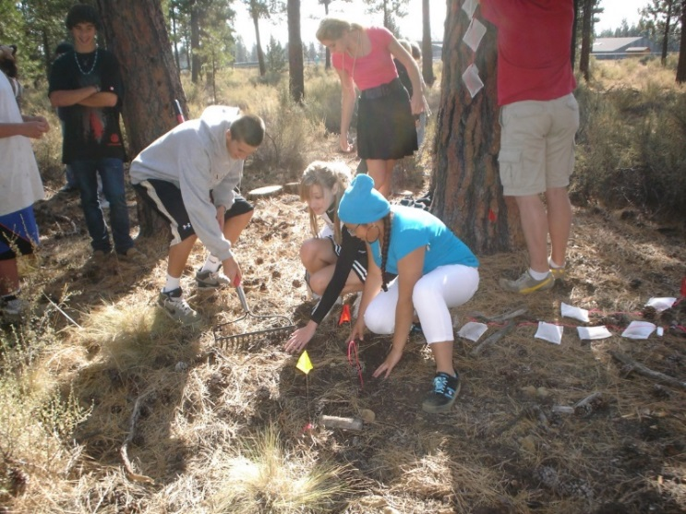
Protocols
placing a known mass of plant litter into fiberglass net bags
collecting the bags at monthly intervals
measuring weight loss over time.
Notes:
We ask teachers to do what they can – once a month seems too hard – most have tried for 3 times/year.

Slide 11
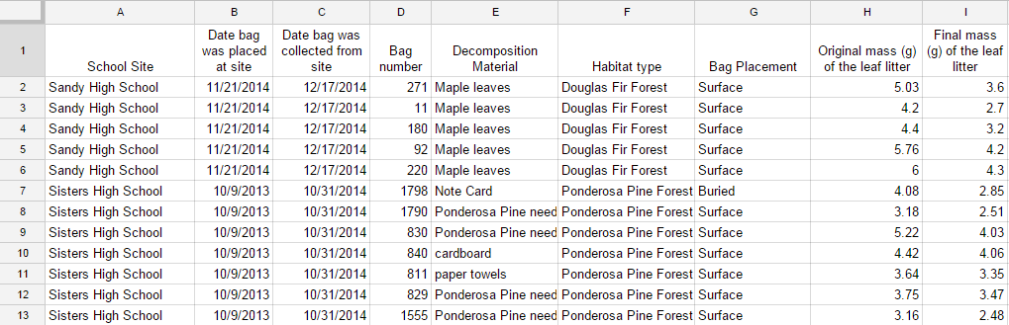
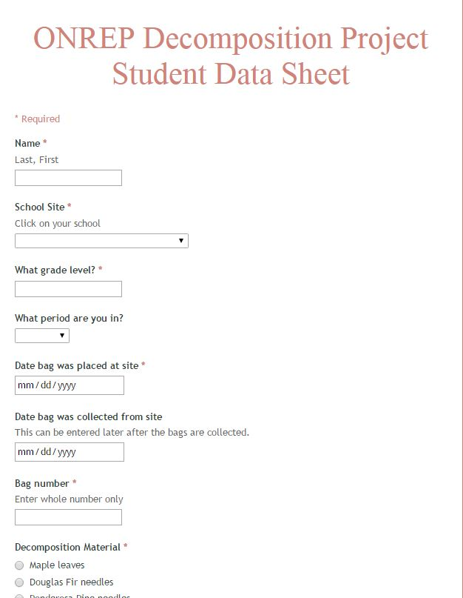
Data analysis
Students enter mass of litter once it is collected and record data in a shared Google form.
Data can then be accessed and analyzed by all participants.

Slide 12
Figure 2. Mass of leaf litter remaining (%) as a function of time left in the field for two forest sites at Sandy High School.
Notes:
Figures

Slide 13
Climate
(environmental conditions)
Plant litter quality
Decomposers
(chemical composition)
(nature and abundance)
Notes:
Study can be tied to this model of factors affecting decomposition.

Slide 14
For more information, see:
http://onrep.forestry.oregonstate.edu/decomposition-project
Notes:
Map of participating schools (needs to be updated)
Mention video, and links to protocols,
Link to Israeli website to get data from their effort as well. Downloaded in excel.
figures, and data entry
Teacher numbers

Slide 15
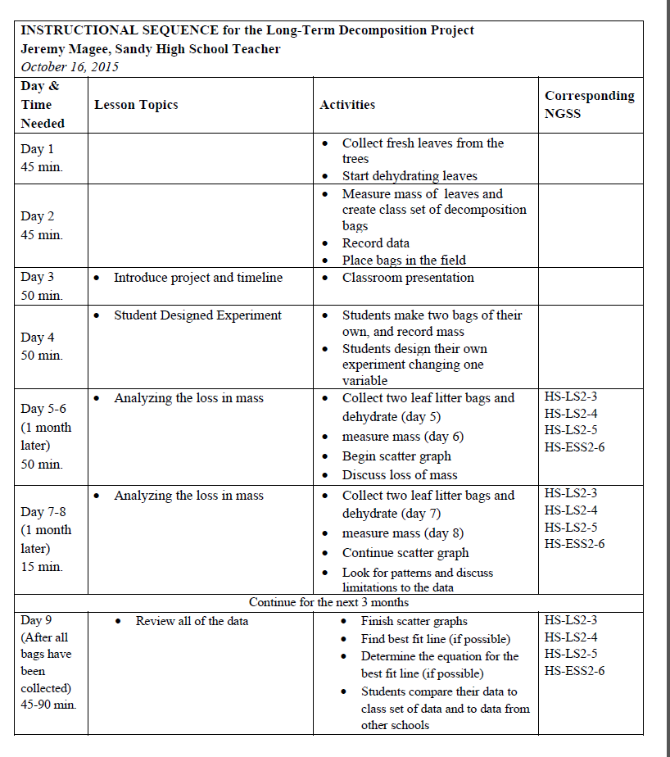

Slide 16
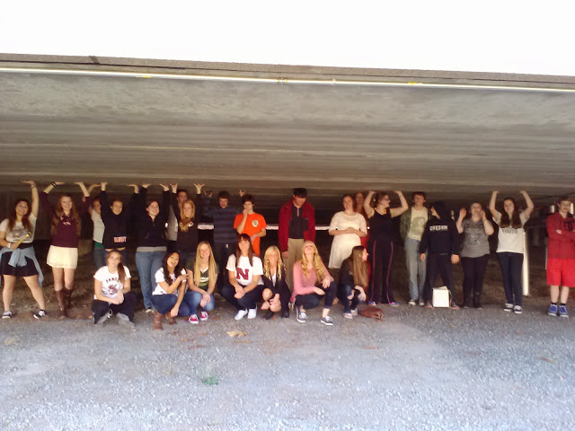
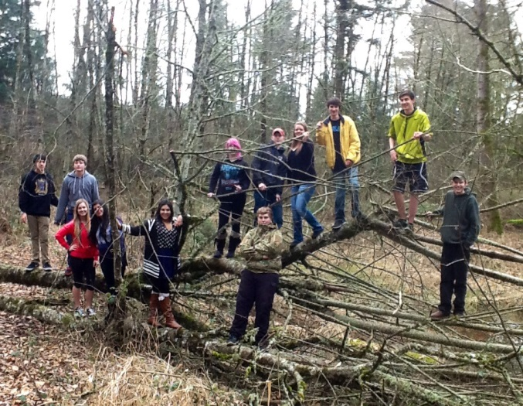

Slide 17
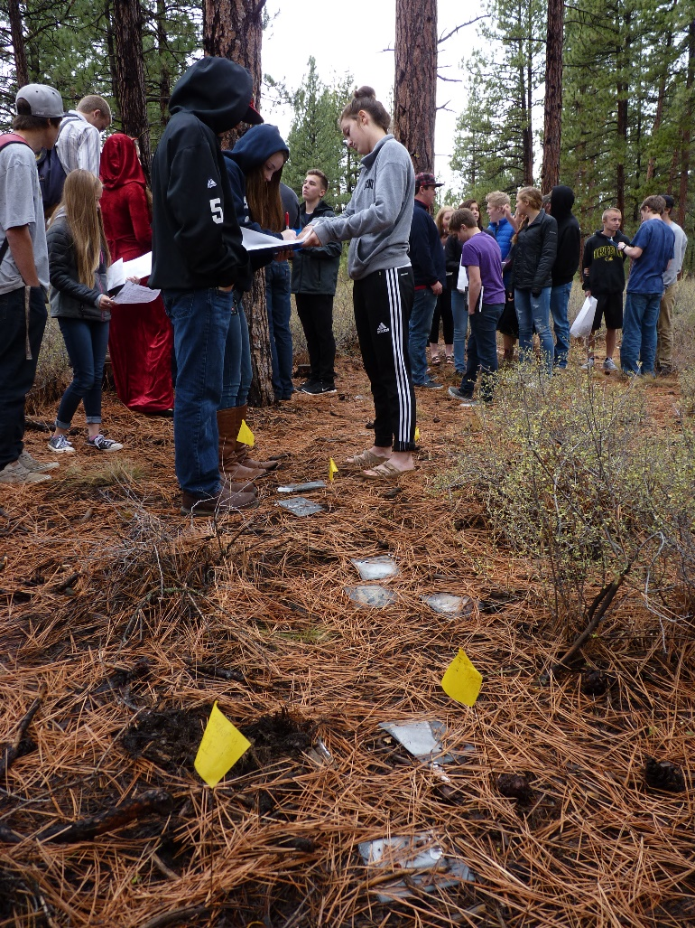
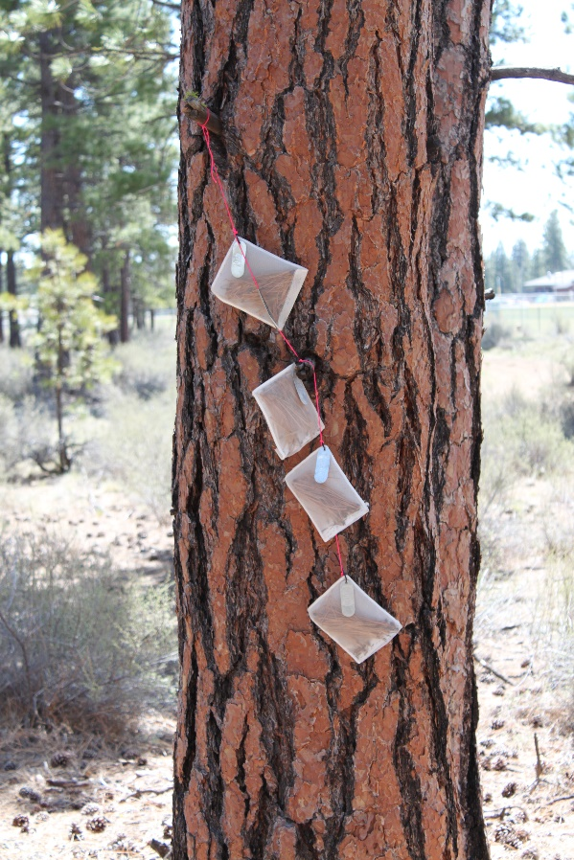
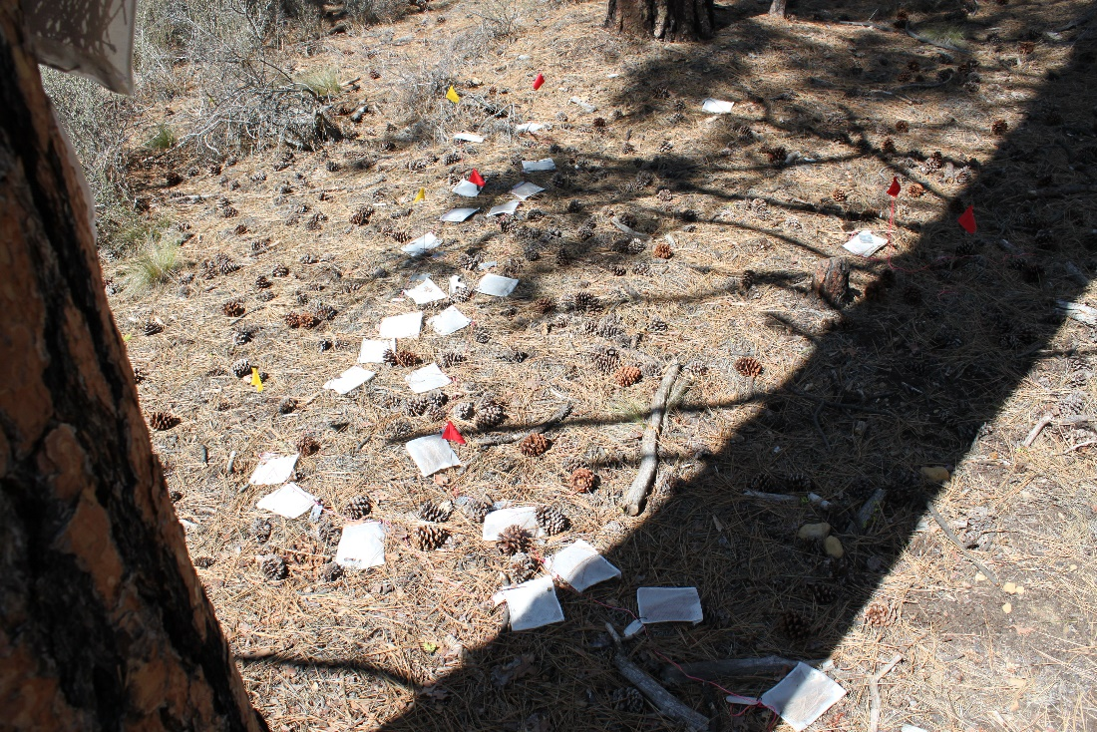
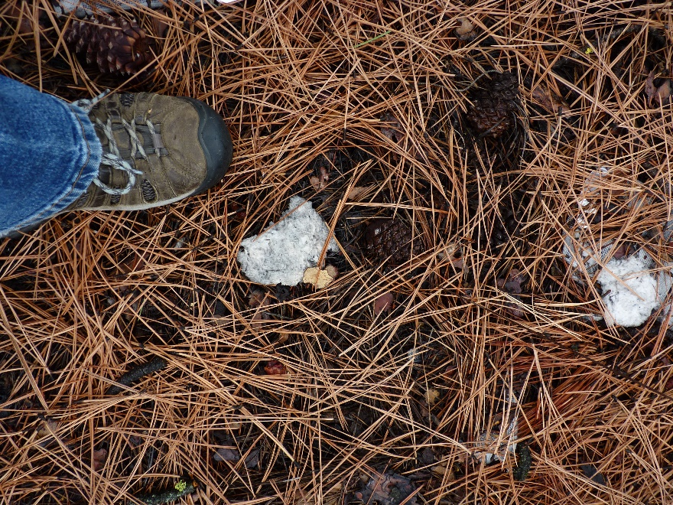

Slide 20
https://docs.google.com/forms/d/1E4Od4sNMPGwuEUfzD6l6Zep9waEXBCryk4pfck5_k-Y/viewform

